Slide 1

PowerShell Contributing
For Everyone

Slide 2

PowerShell Contributing
For Everyone!

Slide 3

Obstacles
What holds you back?
C# knowledge
Never used GitHub
Am I good enough?
Don’t know how to start
…

Slide 4
You can contribute!
Obstacles
But you can
C# knowledge
Never used GitHub
Am I good enough?
Don’t know how to start
…
Contribute feedback, reproduce bugs, write documentation
Just start using GitHub, and there are places to ask help
Do you want to become better?
There’s a blog for that ☺

Slide 5

10 ways of contributing
File a bug report
Help confirm bugs
Comment on language change proposals
Attend the monthly PowerShell community call
Suggest an improvement (feature request)
Contribute Help content
Write Pester tests
Write C# code for PowerShell
Write C# xUnit tests
Write an RFC

Slide 6

DEMO TIME

Slide 7
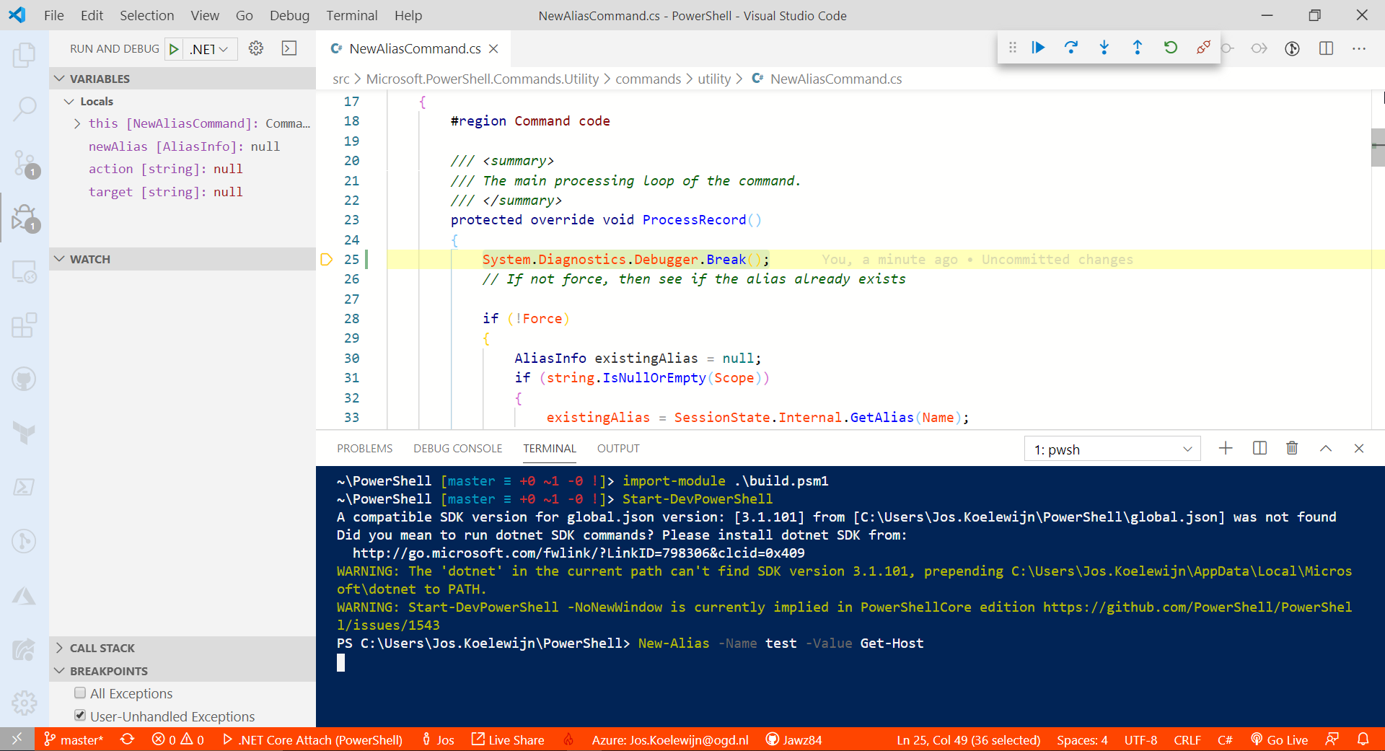

Slide 8

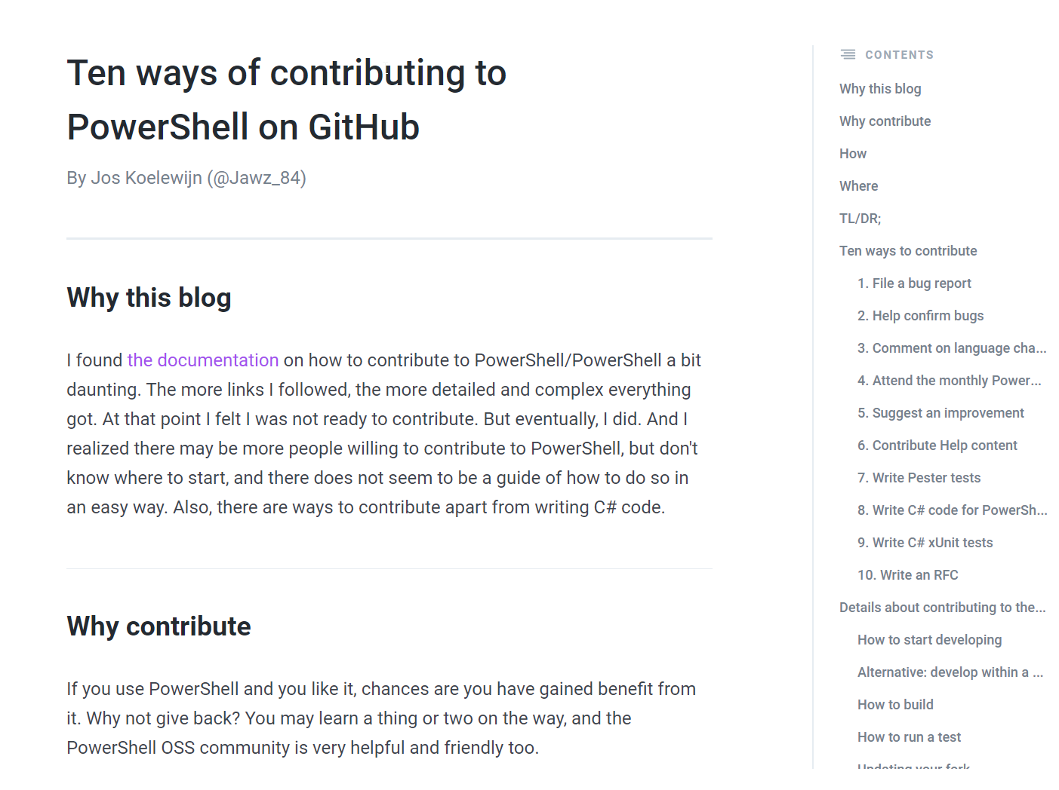


THANK YOU
JOS KOELEWIJN
@jawz_84
joskw.gitbook.io/blog

